Slide 1



Local Authority District Heating Strategy Programme
www.districtheatingscotland.com
Working together for a decarbonised heat sector
^{In partnership with:}

Slide 2
Agenda
Agenda for HNP District Heating Strategy Day 1 (September 1st Inverness)
10.00 – 10.30 | Registration and Coffee
10.30 – 12:15 | Introduction AC (20 min) Local Authority feedback and progress update workshop (55 min) (Allan Crooks, Resource Efficient Scotland) Case Study – the benefits of a strategic approach– Peter North (30 min)
12:15 – 13:00 | Lunch – buffet style – sandwiches/wraps/cakes/fruit

Slide 3
Agenda
Agenda for HNP District Heating Strategy Day 1 (September 1st Inverness)
 | Module 3 – Planning
13:00 – 13.15 | Introduction (Michael Westwater, Scottish Government - Planning)
13.15– 14.05 | Case Studies from Planning Authorities Inverness event - (Ali Bledowski – Aberdeenshire) (25 min) (Peter Marshall – Perth & Kinross) (25 min) Glasgow event - (Alan Duff - Glasgow City) (25 min) (Alexandra Lewis – Falkirk) (25 min)
14:05 – 14:30 | Experiences from Denmark Inverness event – (Borup DH, Anders Hasselager, Bo Riisgaard Pedersen) Glasgow event – (Gladsaxe, Torsten Malmdorf, Thomas Engell -Gladsaxe municipality)
14:30 – 14:45 | Planning Panel Q@A
14.45 – 15:05 | Break – coffee and biscuits
15:05– 15:50 | Energy Masterplanning (Scottish Enterprise) (45 min) Calum Davidson – Inverness (15min presentation and 30min Workshop) Euan Dobson – Glasgow (15min presentation and 30min Workshop)
15:50– 16:05 | Case Study (TBA)
16:05 – 16:30 | Day 1 Wrap up and HNP 1-2-1 sessions (Allan Crooks, Resource Efficient Scotland /Paul Moseley, Scottish Futures Trust)

Slide 4
Agenda
Agenda for HNP District Heating Strategy Day 2 (September 2nd Inverness)
09:00 – 09:30 | Registration and Coffee
 | Module 4 – Business, commercial and financial models
09:30 – 09:55 | Introduction – approaches to delivering heat networks (Paul Moseley, Scottish Futures Trust)
09:55 – 10:15 | Group Workshop – risk identification
10:15 – 10:35 | Feedback from group workshop – discussion on risks
10:35 – 10:50 | Break – coffee and biscuits
10:50 – 11:10 | Commercial strategies (Charles Smith, Brodies)
11:10 – 11:55 | Group Workshop – commercial strategy
11:55 – 12:15 | Financing (Toby Tucker, Scottish Futures Trust)
12:15 – 12:30 | Business case development (Paul Moseley, Scottish Futures Trust)
12.30 – 13.30 | Lunch – buffet style – sandwiches/wraps/cakes/fruit

Slide 5
Agenda
Agenda for HNP District Heating Strategy Day 2 (September 2nd Inverness)
 | Module 5 – Project Identification
13:30 – 14.20 | From concept to construction (Allan Crooks, Resource Efficient Scotland) Criteria Setting and prioritisation (30 min) Feasibility Study (10 min) Investment grade report (10 min)
14.20– 15.15 | Enabling Support (Rebecca Carr, Scottish Government – Energy) Introduction RC (5 min) District Heating Loan fund (20 min) Flexible tea break (15min) LCITP (15 min)
15:15 – 16:00 | Reflection / Identifying the next steps workshop (Allan Crooks, Resource Efficient Scotland)

Slide 6
Why have a Strategy?
Reactive approach to individual energy supply opportunities;
Provides a clear path to implementing;
Local development plans require the consideration of heat networks;
Benefits of Joint Working
Knowledge sharing and problem solving
Access to HNP expertise for advice and support;
One to one consultancy advice on strategy development and local issues;
Template documents and tools

Slide 7
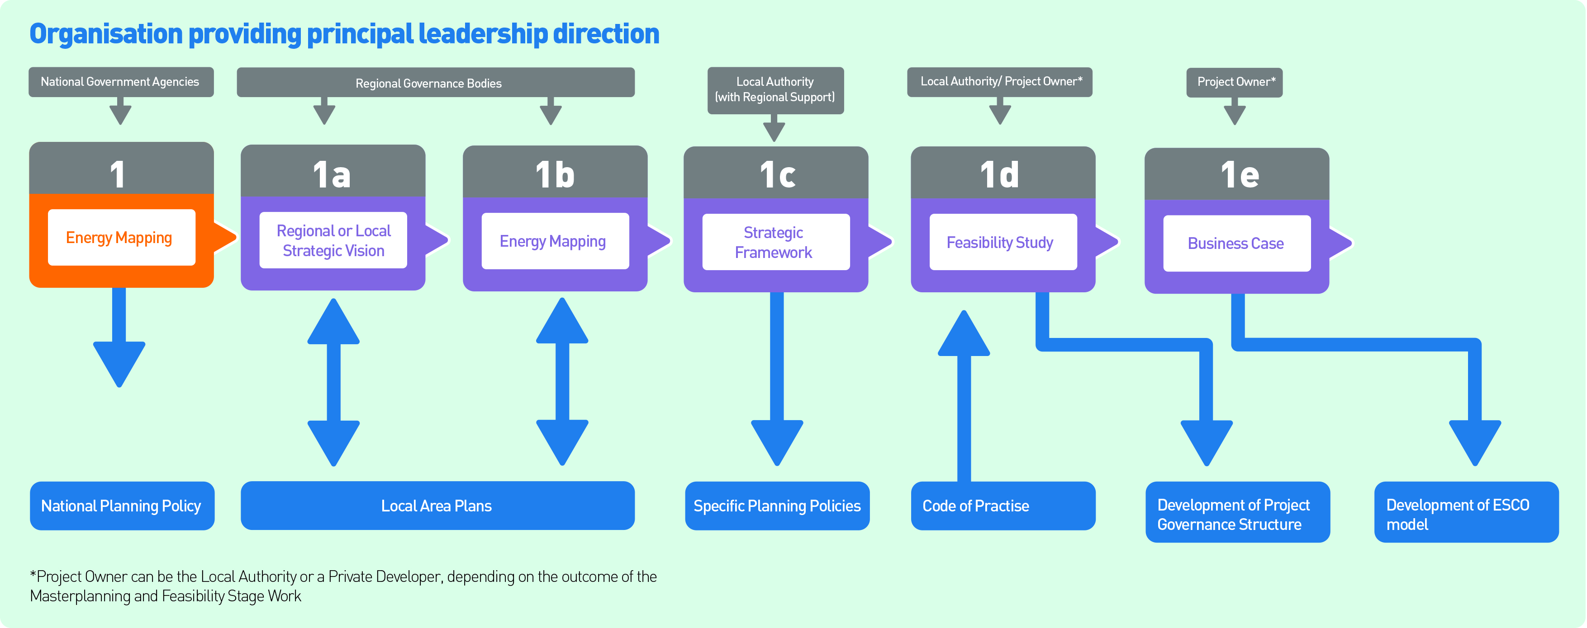
National
Energy
Mapping
Regional or Local Strategic Vision
Strategic Framework
Energy Masterplanning
Feasibility Study
Business Case
Strategic Framework
Master-Planning

Slide 8
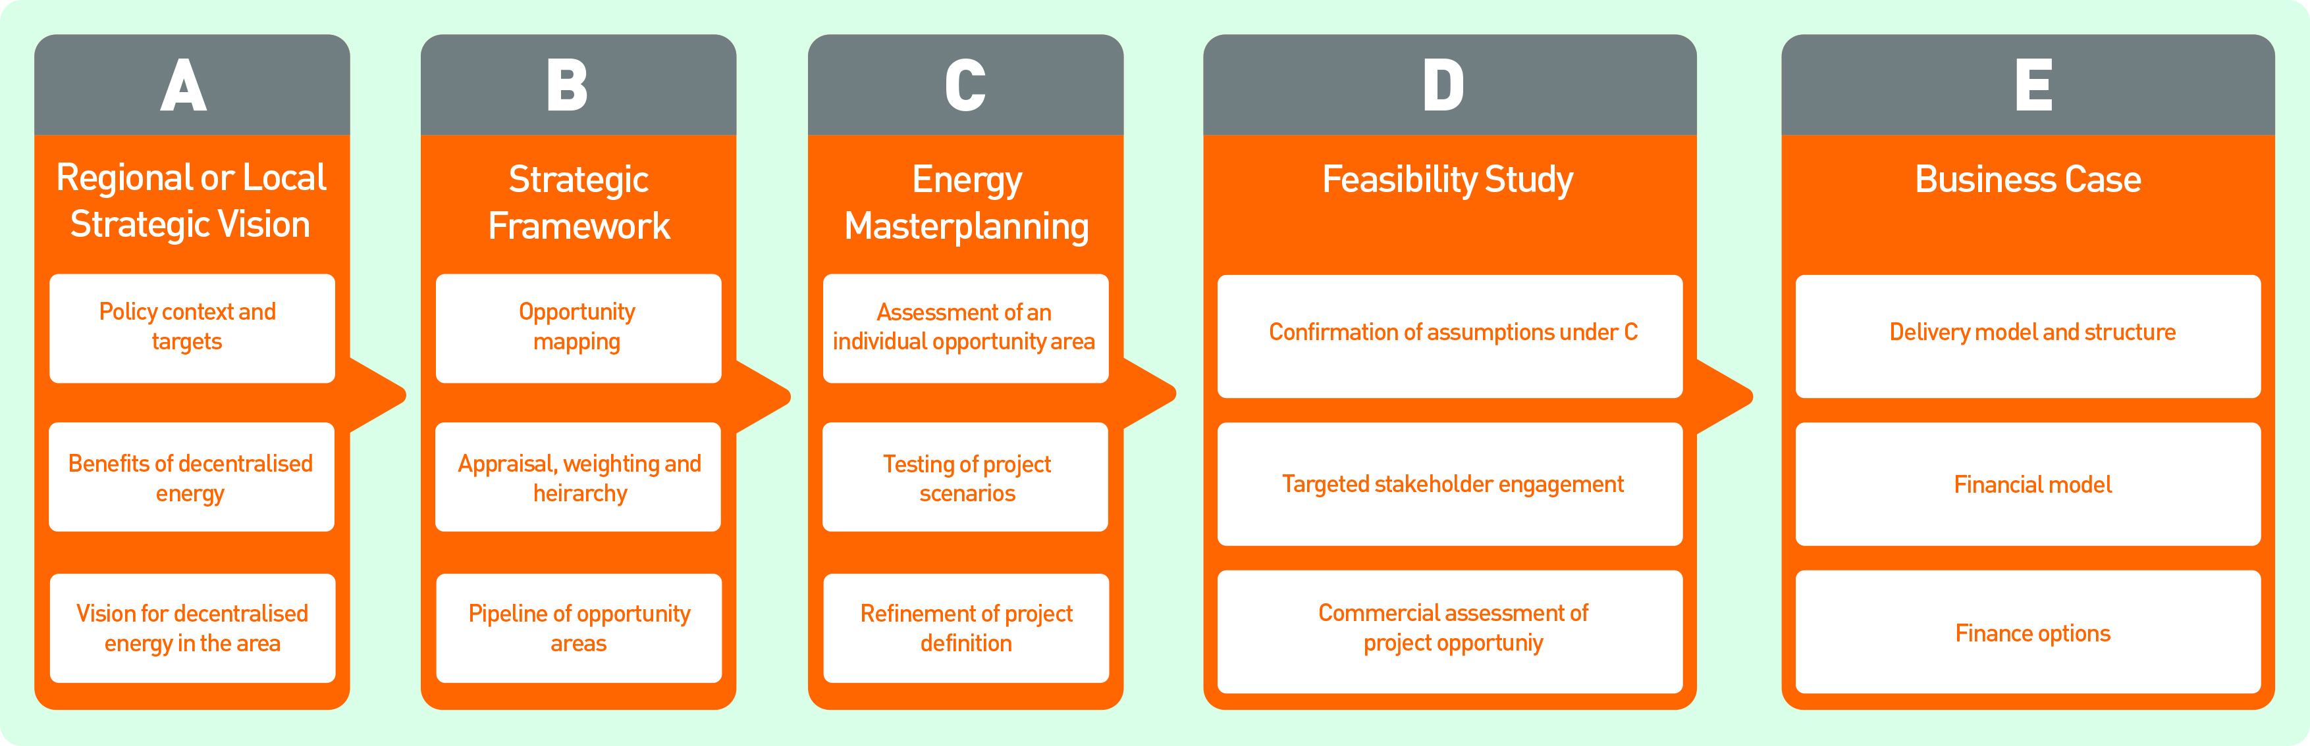
Opportunities Mapping
Delivery Model & Structure
Appraisal Weighting and Hierarchy
Stakeholder Engagement
Finance Model
Commercial Assessment of Project Opportunities
Pipeline of Opportunity Areas
Finance Options

Slide 9
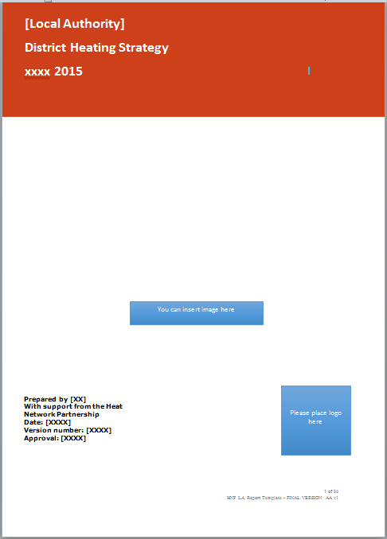
Strategy Template
Provides guidance on the content and structure of a district heating strategy
The strategy document will define the steps a Local Authority will take to implement district heating.
The document is intended to put in place formal and practical plans for communicating, seeking approval of, and implementing district heating
Integrated into wider council strategy

Slide 10
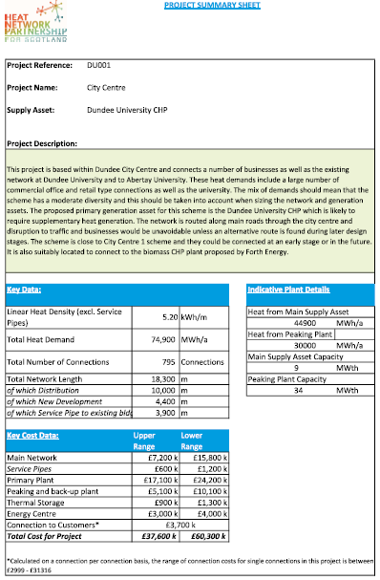
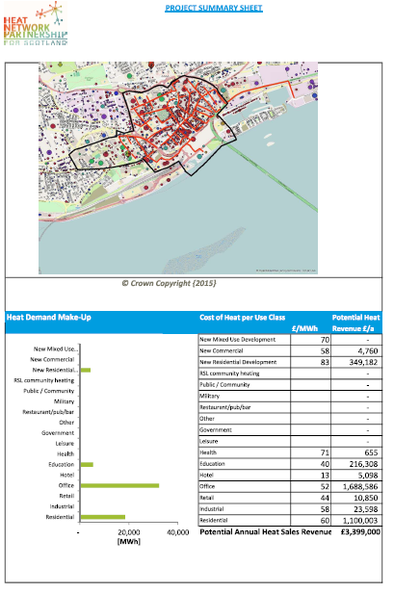
Opportunity Assessment
Opportunity Assessment Tool
Interface with heat map information
Dashboard report on individual projects
High level project information
  Pre-feasibility
Total heat demand
Network length
Outline costs (benchmark analysis)
Webinar

