Slide 1
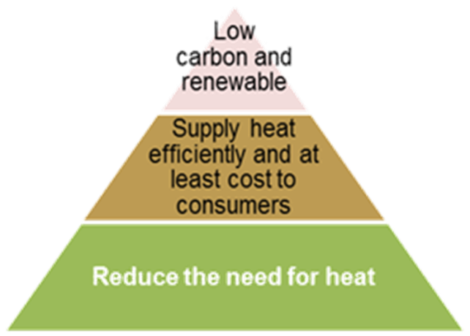
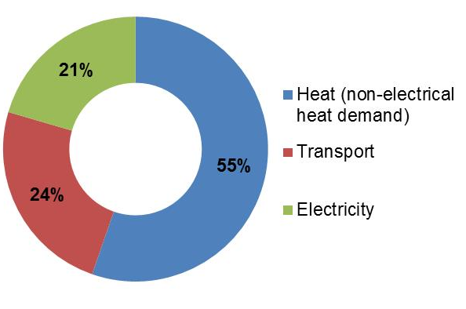
Local Heat and Energy Efficiency
Ambition: drive economic growth and competitiveness, and support efforts to tackle inequality, by enabling every household, business, public sector and third sector organisation to use less energy, reduce their fuel costs and cut their carbon emissions.
Heat vision:
a commercially viable, diverse industry delivering resource efficiency, low carbon and renewable heat to serve Scotland's heat needs
£2.6 billion a year on heating and cooling our homes, and organisations
Strategic direction through our Heat policy
largely decarbonised heat system by 2050, with significant progress by 2030:
Clear ambition for district heating
Programmes supporting uptake of Renewable Heat Incentive
Energy Efficiency:
Scotland’s energy consumption in 2012 was 11.8% lower than 05-07
Created the Resource Efficient Scotland advice and support programme, supporting over 33,000 organisations to realise over £49 million and 910 GWh of lifetime energy savings

Slide 2

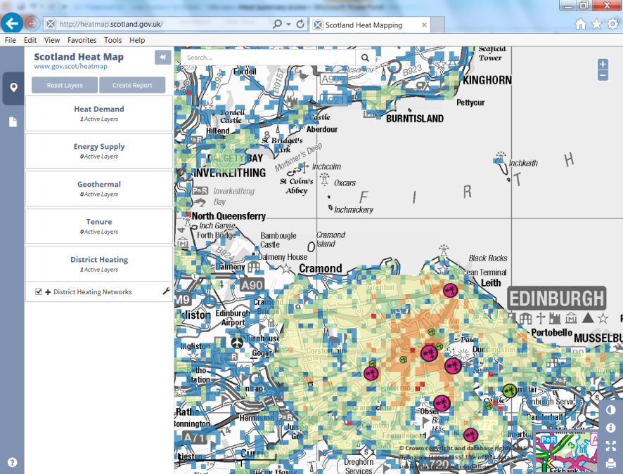



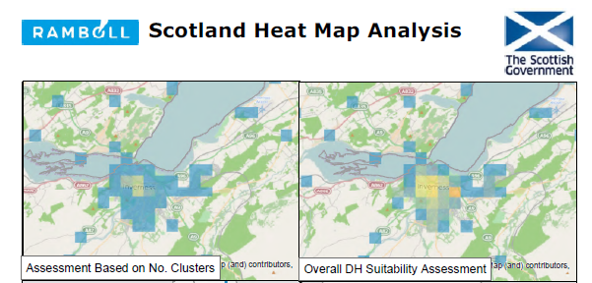
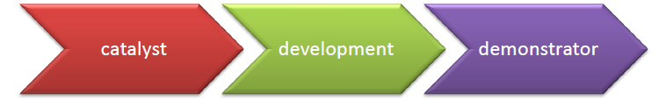
Local Heat and Energy Efficiency
Heat Network Partnership
Coordinated programme of support
for district heating:
Project directory
Knowledge Hub (case studies,
technical information, reports
Co-funded feasibility studies
Project development support from partners
Low Carbon Infrastructure Transition Programme
£76 million programme, part-funded by ESF, to boost jobs and economic growth in Scotland’s low carbon sector.
Scotland wide, cross-sector project development unit, to support the development and acceleration of over 100 low carbon infrastructure projects in the next 3 years.
www.gov.scot/heatmap

Slide 3
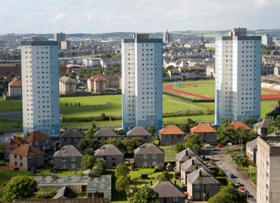
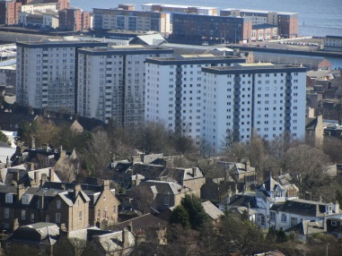
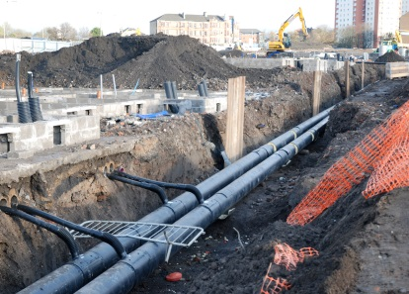
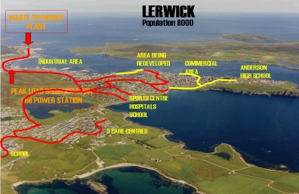
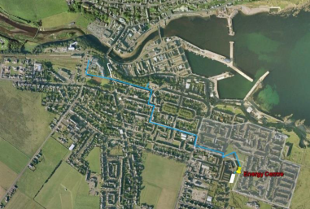
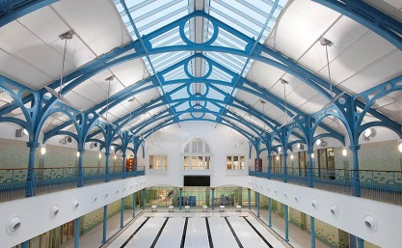
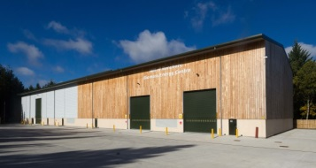
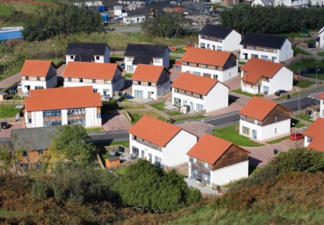
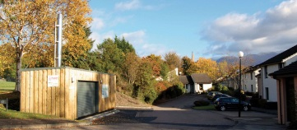
Local Heat and Energy Efficiency
Existing Heat Networks
122 operational projects
around 10,000 homes
connected + schools,
hospitals and other public
buildings
Local authority led
  city district heating
  and communal heating
  Urban and rural towns
  – renewable district
  heating
small-scale social housing and
private heat networks –
mainly biomass
Aberdeen
Dundee
Glasgow
Lerwick
Wick
Dunfermline
Banchory - HoBESCo
West Highland HA
Hanover HA

Slide 4
Local Heat and Energy Efficiency
District Heating Development
HNP Partners have provide over £300,000 in support for Local Authority Strategies, Feasibility and Options Appraisals
Strategies
City of Edinburgh Council – Sustainable Upgrade Options for Multi-Storey Domestic Heating Systems (WHF)
City of Edinburgh Council – support for cluster development strategy (RES)
South Lanarkshire Council - Domestic heating system options appraisal for non-traditional low rise properties (WHF)
Renfrewshire Council – Rural District Heating Scheme Strategy Report (WHF)
Renfrewshire Council – Renfrewshire Urban (Renewable) District Heating Feasibility (WHF)
Glasgow City Council – Business case for Glasgow Energy Services Company (SG / SE / SFT)
Project feasibility / options appraisal
West Lothian Council – Kirkhill district heating (WHF)
Fife Council – Business case to extend the Dunfermline Community Energy Scheme (SG / WHF / RES / SFT)
North Lanarkshire Council – Muirhouse (WHF)
Renfrewshire Council – Rowan & Spersfield Sheltered Housing (WHF)
Renfrewshire Council – Alpatrick Gardens options appraisal (WHF)
West Dunbartonshire Council – Queens Quay (WHF / RES)
Fife Council – Methil (WHF / RES)
Falkirk Council – Callendar Park (WHF)
Highland Council – Tain (WHF)
City of Edinburgh Council, University of Edinburgh, NHS Lothian – Bioquarter (SG / SE / RES / SFT)
Argyll & Bute Council, WHHA, NHS Highland – Options appraisal for 3 DH zones in Oban (RES)
South Lanarkshire Council, University of West of Scotland - Options Appraisal & District Heating Feasibility Study at Almada Street, Hamilton (RES)
East Ayrshire – West Dumbarton Road Heat Mapping (RES)
Clackmannanshire Council – Industrial Waste Heat recovery district heating feasibility (RES)
Dundee City Council – Michelin/DERL heat recovery (RES)

Slide 5
Local Heat and Energy Efficiency
Strategic Energy Planning
Scottish Planning Policy
  “Local development plans should use heat mapping to identify the potential for co-locating
  developments with a high heat demand with sources of heat supply.”
  “Local development plans should support the development of heat networks in as many
  locations as possible.”
  “Local development plans should identify where heat networks, heat storage and energy centres exist or would be appropriate and include policies to support their implementation.”
Related policies including
Local Housing Strategy
Carbon Management Plan
Economic Development
Sustainable Energy Action Plan
Energy Masterplanning
Key stakeholders
Internal
Other public bodies
Communities and third sector
Private sector
NGOs

